Slide 1




OECD ECONOMIC SURVEY
OF ITALY 2017
Reforms are paying off,
but challenges remain
15 February 2017, Rome
http://www.oecd.org/eco/surveys/economic-survey-italy.htm
@OECDeconomy
@OECD
Notes:
Slide 1: I crafted all the bullet points by combining the titles of key recommendations to make sentences.

Slide 2
Overview: Boosting Inclusive Growth in Italy
Structural reforms are starting to pay off:
  Italy has made remarkable progress on structural reforms
  This has helped Italy to emerge from a deep and long recession
Current challenges:
  Slow productivity and investment growth; banks’ non-performing loans are a burden
  More jobs are needed as well as better skills
  Poverty among young and children should be brought down

Slide 3
The economy is finally recovering after a deep and long recession
GDP growth, annual % change
GDP growth, annual % change
Source: OECD Economic Outlook 100 Database, projections revised as of 20 January 2017

Slide 4
Reforms have boosted hirings
Jobs Act enacted in early-2015
Source: Istituto nazionale della previdenza sociale (INPS) Osservatorio sul Precariato.

Slide 5
Higher employment has increased private consumption and growth
Y-o-Y % changes
Source: OECD Economic Outlook 100 Database

Slide 6
Fiscal policy is supporting growth
Source: OECD Economic Outlook 100 Database, updated on 20 January, 2017.

Slide 7
Banks’ non-performing loans are high
Non-performing loans to total gross loans
2016Q2 or latest available
Source: IMF Financial Soundness Indicators.

Slide 8
Good progress on structural reforms
Reforms approved | Ongoing reforms | Reforms to do
Jobs Act Youth Guarantee Spending reviews Budget making process Public procurement code Anti-corruption (ANAC) | Tax evasion and compliance Public administration Competition law National anti-Poverty programme Job-search and training policies Buona Scuola Industry 4.0 Plan | Lowering cash payment thresholds Permanent cut in social security contributions Real estate tax based on updated cadastral values Re-launching infrastructure spending Broad reform of insolvency procedures National anti-poverty programme
Source: OECD compilation.

Slide 9
First challenge:
Boosting growth and reducing banks’ bad debts

Slide 10
Productivity is low but is starting to recover
Source: OECD Economic Outlook 100 Database, projections revised as of 20 January 2017.

Slide 11
Public debt has stabilised but remains high
Note: For more details see Economic Survey of Italy, 2017
Source: OECD Analytical database and OECD calculations.

Slide 12
Low growth has contributed to high public debt
% points, change in public debt as share of GDP
Note: For more details see Economic Survey of Italy, 2017
Source: OECD Analytical database and OECD calculations.

Slide 13
Stronger growth will help reduce public debt
Higher interest rate (+1.4% points)
Baseline
Higher GDP growth (+0.5%)
Note: The baseline scenario considers the projections for the Economic Outlook No. 100 until 2018 and thereafter assuming yearly real GDP growth of 1%, primary surplus of 1.5% of GDP, effective interest rate of 3.2% and inflation of GDP deflator rising progressively to 1.5% by 2024 and remaining constant after.
Source: Calculations based on OECD Economic Outlook: Statistics and Projections (database).

Slide 14
Prioritise spending on effective infrastructure programmes
Source: OECD Analytical Database; and OECD, National accounts database.

Slide 15
Tax collection remains low
Note: The VAT revenue ratio is the ratio of actual VAT collection to revenue that would be collected if VAT was applied at the standard rate to the entire potential tax base and all revenue was collected.
Source: OECD Consumption Tax Trends 2016: VAT/GST and excise rates, trends and policy issues.

Slide 16
Lowering social security contributions will boost job creation
Average social security contribution (SSC) rate
ITA
Source: OECD Taxing Wages.

Slide 17
Reducing banks’ bad debts is urgent
%
Bad debts (sofferenze) as % of total outstanding loans
Note: For more details see Economic Survey of Italy, 2017.
Source: Calculations based on OECD Economic Outlook No. 100: Statistics and Projections Database.
Set gradual and bank-specific targets to reduce non-performing loans, backed up by sanctions.

Slide 18
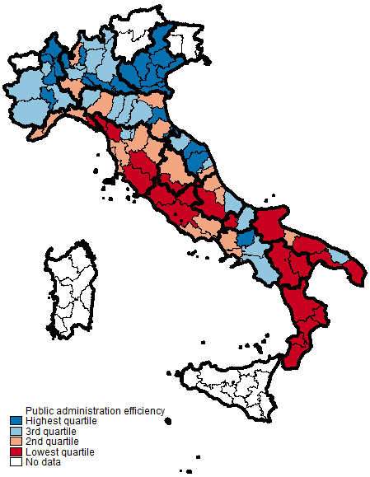
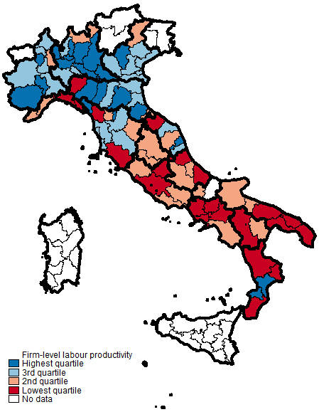
Productivity is higher where public administration is more efficient
Note: For more details see Economic Survey of Italy.
Source: OECD calculations using ORBIS and Open Civitas data.

Slide 19
A more efficient public administration raises firms’ productivity
Effect on firms performance of increasing public administration efficiency from the bottom quartile to the top quartile of the province-level distribution
Note: For more details see Economic Survey of Italy, 2017.
Source: OECD calculations based on ORBIS database and OPEN CIVITAS data

Slide 20
Insolvency procedures are slow and costly
Source: Doing Business 2016: Measuring Regulatory Quality and Efficiency (Resolving insolvency database).
Facilitate the emergence of insolvent firms as viable firms by using debt-equity swaps.

Slide 21
R&D spending is low
Source: OECD Main Science and Technology Indicators database
Evaluate the effectiveness of recently introduced R&D fiscal incentives included in the Industry 4.0 plan.

Slide 22
Main recommendations
Sustaining inclusive growth
Continue on the path of prudent fiscal policies and prioritise spending on effective infrastructure and innovation programmes.
Increase tax revenues by enhancing tax compliance (by investing more in IT systems and human resources, extending the use of e-invoicing and lowering the threshold for cash payments); and introduce real estate taxes based on updated cadastral values.
Use additional tax revenues to gradually reduce social security contributions on permanent contracts.

Slide 23
Main recommendations
Sustaining inclusive growth
Continue to develop the secondary market for NPLs.
As envisaged by the European Supervisory Mechanism, set gradual and bank-specific targets to reduce NPLs, backed up by sanctions such as additional provisioning, sales of assets, suspension of dividend payments and restructuring banks’ operations.
If public funds are needed to recapitalise distressed banks, take full advantage of EU regulations, imposing losses on equity and bondholders, and restructuring banks’ operations. Compensate retail bondholders for the losses they will incur.
More in the Assessment & Recommendations

Slide 24
Main recommendations
Improving the business environment
Continue efforts to enhance the efficiency and transparency of the public administration by: making further progress on e-services; fully implementing the broad public administration reform; amending the parts of public-administration reform blocked by the Constitutional Court and swiftly implementing them.
Use debt-equity swaps more frequently by forcing creditors to share the burden of firm restructuring.
Approve the competition law under discussion by Parliament.
Evaluate the effectiveness of recently introduced research and development tax credits and other fiscal incentives in terms of innovation outcomes and forgone tax receipts.
Foster the development of the venture capital industry by leveraging private funds and expertise.
More in Chapter 1 of the Economic Survey

Slide 25
Second challenge:
Improving skills

Slide 26
Unemployment has fallen but remains high
Unemployment rate, %
Youth unemployment rate, %
Source: OECD, LFS database, Employment and unemployment (LFS)

Slide 27
Skills are low
Average literacy score-points
Average literacy score-points
Source: OECD Secretariat calculations using Survey of Adults Skills (PIAAC) 2012.

Slide 28
Skill mismatches are high
Source: Survey of Adults Skills (PIAAC) (2012).

Slide 29
Spending on job-search and training policies can be increased
% of GDP
Spending on active labour market policies
Source: OECD (2016c), OECD Employment and Labour Market Statistics.

Slide 30
School results can further improve
Source: OECD PISA 2006, 2009, 2012 and 2015 Databases
Build partnerships between schools and firms to create high quality work-placements for students as foreseen by the Good School reform.

Slide 31
High level vocational education and training should be scaled up
Source: OECD Education at a Glance 2016.

Slide 32
Main recommendations
Enhancing skills
Employ more specialised counsellors and profiling tools in the public employment services.
Assess the labour market impact of job-search and training programmes and focus funding on those that are performing well.
Build partnerships between schools and businesses to create high quality work-based learning for students as envisaged by the Good School reform.
Scale up post-secondary VET with strong involvement of the business sector, based on the example of Istituti Tecnici Superiori.
Establish a national body on VET involving the business sector and all key stakeholders to link the training component of VET with apprenticeships; ensure high-quality workplace training and identify skills needed in the labour market.
More in Chapter 2 of the Economic Survey

Slide 33
Third challenge:
Reducing poverty

Slide 34
Poverty among households with children has increased
Source: Istat.

Slide 35
The share of transfers helping the poorest has decreased
Source: OECD Income Distribution database.

Slide 36
The transfer system is poorly targeted
Share of total cash transfers received by the lowest income decile, 2013
Source: OECD Income Distribution database.

Slide 37
Main recommendations
Reducing poverty
Fully legislate and implement the planned nationwide anti-poverty programme, target it towards the young and children and ensure it is sufficiently funded.
More in the Assessment & Recommendations

Slide 38

For more information
Disclaimers:
The statistical data for Israel are supplied by and under the responsibility of the relevant Israeli authorities. The use of such data by the OECD is without prejudice to the status of the Golan Heights, East Jerusalem and Israeli settlements in the West Bank under the terms of international law.
This document and any map included herein are without prejudice to the status of or sovereignty over any territory, to the delimitation of international frontiers and boundaries and to the name of any territory, city or area.
http://www.oecd.org/eco/surveys/economic-survey-italy.htm
Follow us on twitter:
OECD Economics
OECD

